Slide 1



LIBRARY MANAGEMENT SYSTEM
CSE2004 J-Component project

Slide 2


LIBRARY MANAGEMENT SYSTEM
COURSE FACULTY: SIVABALAKRISHNAN N
COURSE TITLE: DATABASE MANAGEMENT (CSE2004)
SEMESTER: WINTER 2020-2021
SLOT:D2
TEAM MEMBERS:
G.BARANIRAJ-20BAI1172
ANANT TATER-20BAI1127
SHATAKSHI SHREE-20BAI1314

Slide 3
INTRODUCTION
Library Management System is a system which maintains the information about the books present in the library, their authors, the members of library to whom books are issued, library staff and all. This is very difficult to organize manually. Maintenance of all this information manually is a very complex task. Owing to the advancement of technology, organization of an Online Library becomes much simple. The Online Library Management has been designed to computerize and automate the operations performed over the information about the members, book issues and returns and all other operations. This computerization of library helps in many instances of its maintenances. It reduces the workload of management as most of the manual work done is reduced.

Slide 4
PROJECT OBJECTIVE/PROBLEM STATEMENT
The aims and objectives are as follows:
The issue of books by online mode.
Columns provided to search book online.
Requests to the librarian can be sent to provide new books in the column.
Login portal for a student for security purposes of the library.
Homepage for the student which has different buttons to navigate to pages containing the date of issue, date of return, fine charges, etc.
Columns for teachers to get the book issued if desired.
Requests column for teachers to ask for the introduction of new or essential books in the library.
Maintaining records of the librarian and other library staff.
Feedback page to be viewed and monitored by the college authority, to which student.
The teacher can mention any misbehave or feedback to the library.

Slide 5
REQUIREMENTS:
Hardware Requirements:
Processor- Dual core intel Pentium (Xeon) family or higher recommended.
RAM- 4GB RAM or more recommended for database or combined web/database server.
HDD- 40GB or more recommended.
Any PC/laptop which is capable of running Django and Visual Studio.
Intel core i5 2nd generation is used as a processor because it is fast than other processors an provide reliable and stable and we can run our pc for longtime. By using this processor we can keep on developing our project without any worries.
Software Requirements:
Operating system:-Linux, Windows 10/8/8.1, Mac.
Text editor like Visual Studio Code for programming.
Operating system- Windows 7 is used as the operating system as it is stable and supports more features and is more user friendly
Database MYSQL-MYSQL is used as database as it easy to maintain and retrieve records by simple queries which are in English language which are easy to understand and easy to write.

Slide 6
BACK END:
PHYTHON:
Python is an interpreted, object-oriented, high-level programming language with dynamic semantics. Its high-level built in data structures, combined with dynamic typing and dynamic binding, make it very attractive for Rapid Application Development, as well as for use as a scripting or glue language to connect existing components together. Python's simple, easy to learn syntax emphasizes readability and therefore reduces the cost of program maintenance. Python supports modules and packages, which encourages program modularity and code reuse. The Python interpreter and the extensive standard library are available in source or binary form without charge for all major platforms, and can be freely distributed.Python works on different platforms (Windows, Mac, Linux, Raspberry Pi, etc).
Python has a simple syntax similar to the English language.
Python has syntax that allows developers to write programs with fewer lines than some other programming languages.
Python runs on an interpreter system, meaning that code can be executed as soon as it is written. This means that prototyping can be very quick.
Python can be treated in a procedural way, an object-oriented way or a functional way.

Slide 7
MYSQL
-MySQL("My S-Q-L", officially, but also called "My Sequel") is (as ofJuly 2013) the world's second most widely used open-source relational database management system (RDBMS). It is named after co-founder Michael Widenius daughter, My. The SQL phrase stands for Structured Query Language. The MySQL development project has made its source code available under the terms of the GNU General Public License, as well as under a variety of proprietary agreements. MySQL was owned and sponsored by a single for-profit firm, the Swedish company MySQL AB, now owned by Oracle Corporation .MySQL is a popular choice of database for use in web applications, and is a central component of the widely used LAMP open source web application software stack (and other 'AMP' stacks). LAMP is an acronym for "Linux, Apache, MySQL, Perl/PHP/Python." Free-software-open source projects that require a full-featured database management system often use MySQL. For commercial use, several paid editions are available, and offer additional functionality. Applications which use MySQL databases include: TYPO3, MODx, Joomla, WordPress, phpBB, MyBB, Drupal and other software. MySQL is also used in many high-profile, large-scale websites, including Wikipedia, Google (though not for searches), Facebook, Twitter, Flickr, and YouTube.

Slide 8


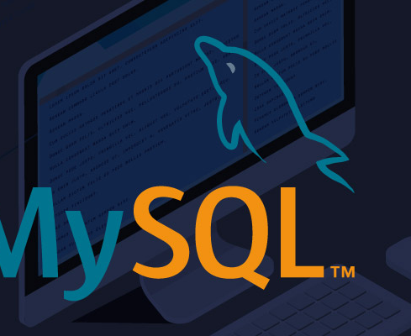

Slide 9
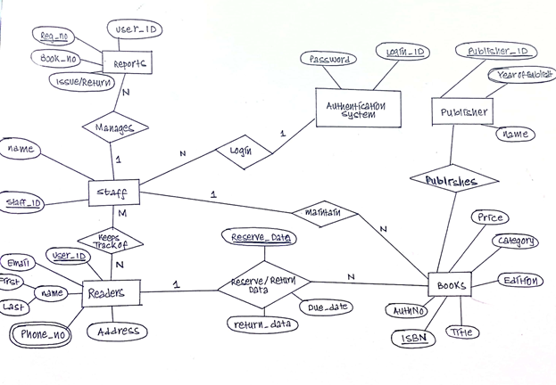
ER DIAGRAM

Slide 10
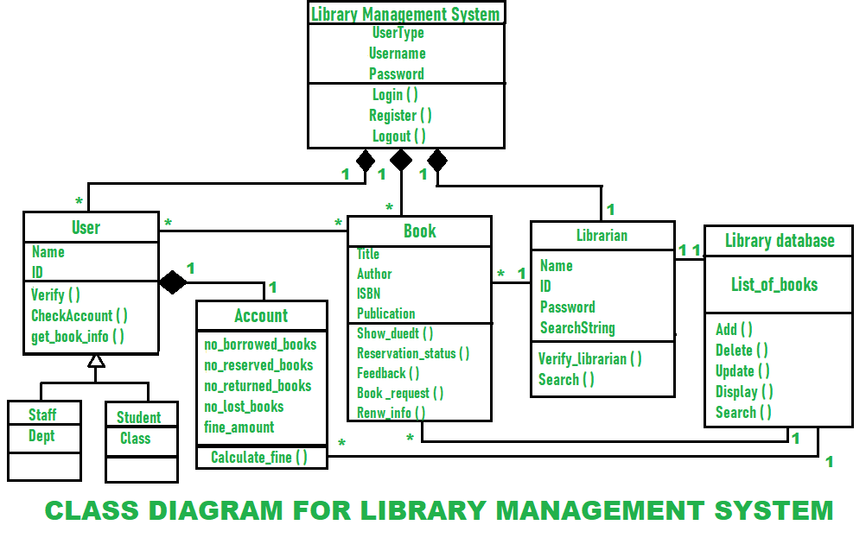

Slide 11

ABOUT THE PRODUCT
A Library Management System is a project built to handle the primary housekeeping functions of a library. Libraries rely on library management systems to manage asset collections as well as relationships with their members. Library management systems help libraries keep track of the books and their checkouts, as well as members’ subscriptions and profiles.

Slide 12
SYSTEM REQUIREMENTS
We will focus on the following set of requirements while designing the Library Management System:
Librarian should be able to log in into the system with his/her User ID and Password.
Any library member should be able to search books by their title, author, subject category as well by the publication date.
Each book will have a unique identification number and other details including a rack number which will help to physically locate the book.
There could be more than one copy of a book, and library members should be able to check-out and reserve any copy. We will call each copy of a book, a book item.
The system should be able to retrieve information like who took a particular book or what are the books checked-out by a specific library member.
There should be a maximum limit (5) on how many books a member can check-out.
There should be a maximum limit (10) on how many days a member can keep a book.

Slide 13
USER INTERFACE

Slide 14
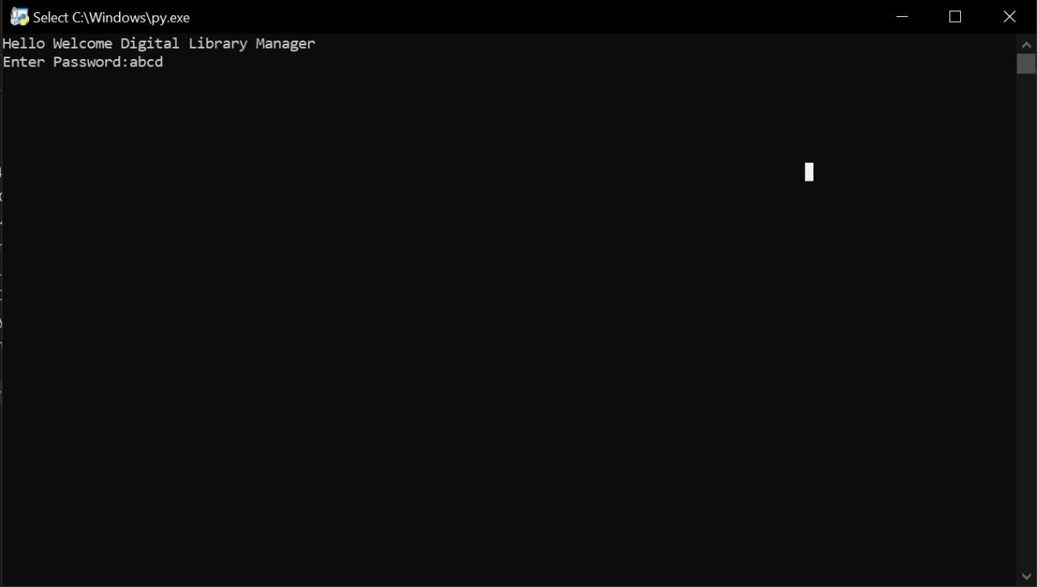

Slide 15
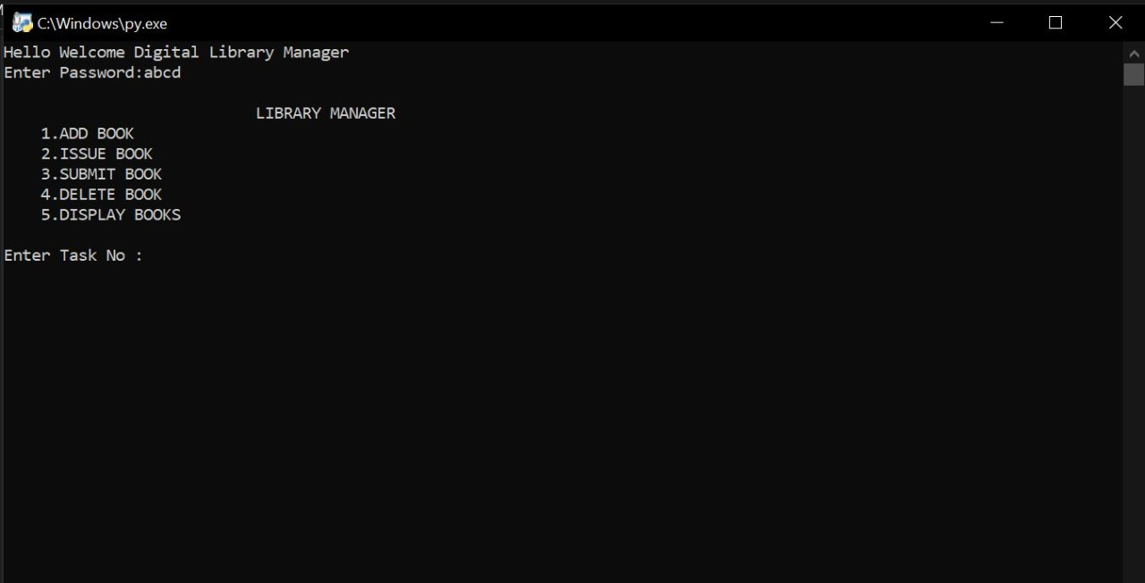

Slide 16
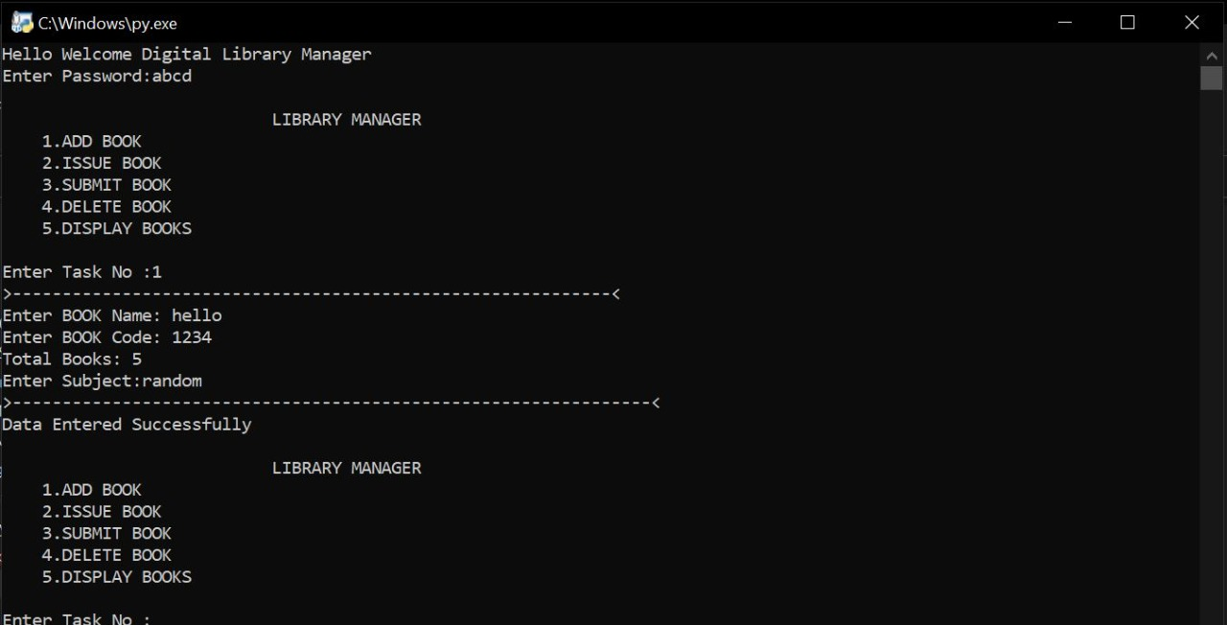

Slide 17
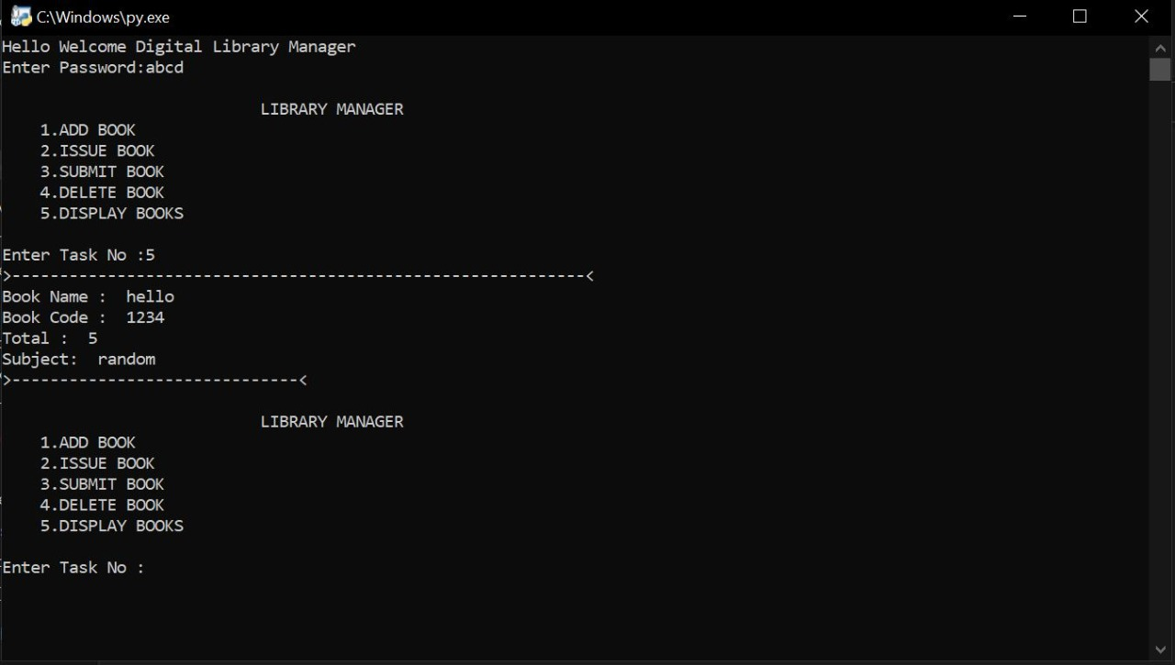

Slide 18
DATABASE

Slide 19
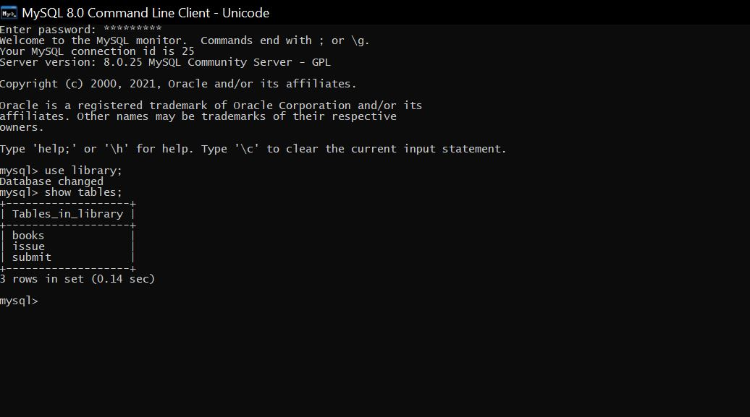

Slide 20
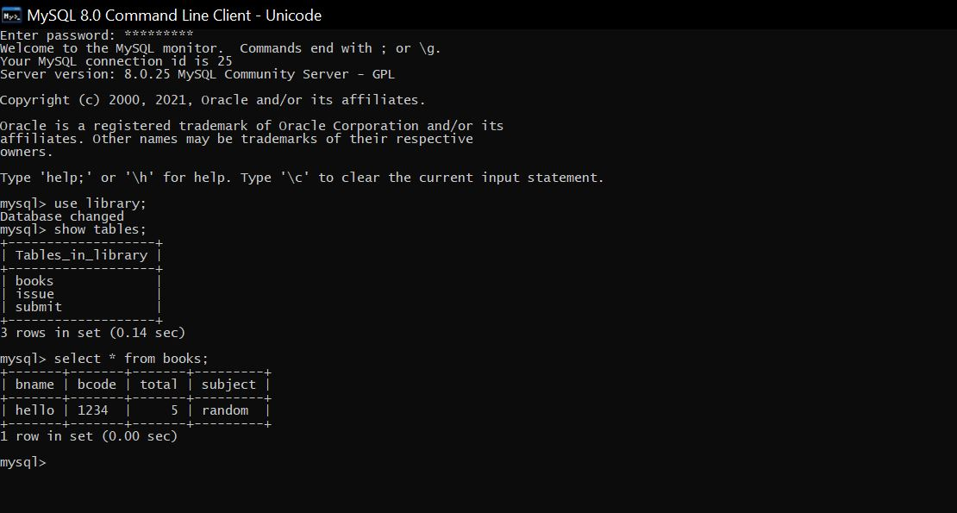

Slide 21
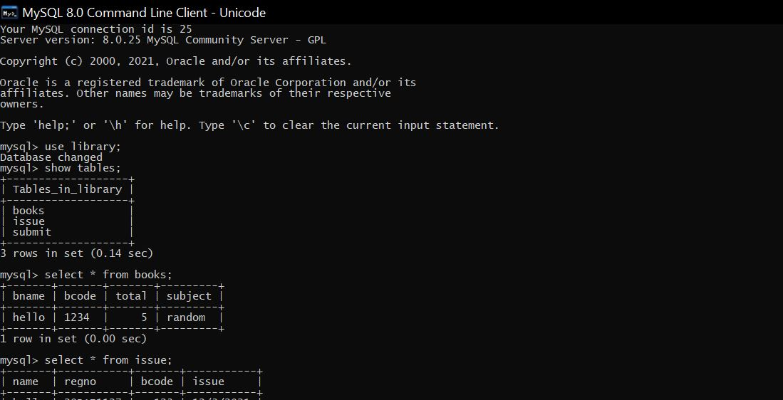

Slide 22
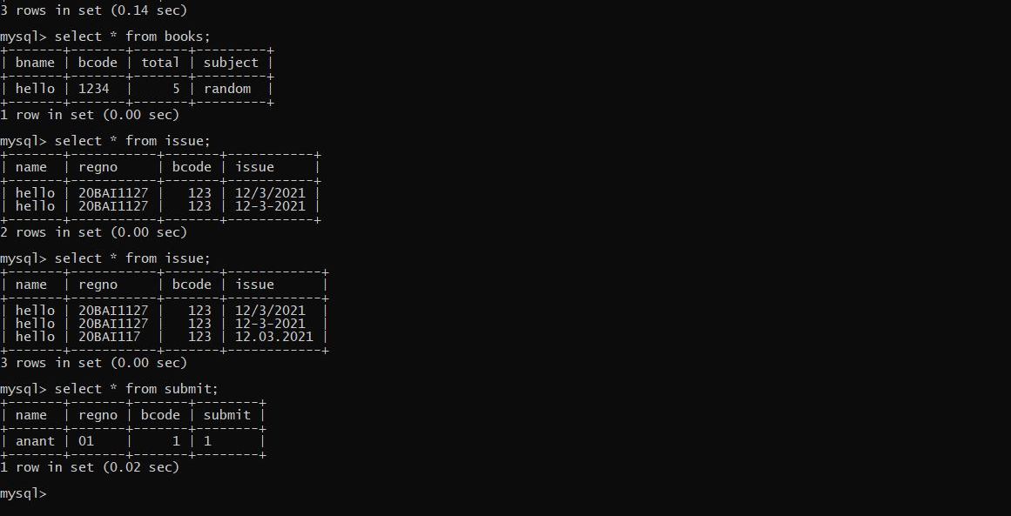

Slide 23
CONCLUSION
This project provides a computerized version of library management system which will benefit the students as well as the staff of the library. It makes entire process online where student can search books, staff can generate reports and do book transactions. It also has a facility for student login where student can login and can see status of books issued as well request for book or give some suggestions. It has a facility of teacher’s login where teachers can add lectures notes and also give necessary suggestion to library and also add info about workshops or events happening in our college or nearby college in the online notice board. There is a future scope of this facility that many more features such as online lectures video tutorials can be added by teachers as well as online assignments submission facility , a feature Of group chat where students can discuss various issues of engineering can be added to this project thus making it more interactive more user friendly and project which fulfills each users need in the best way possible.

Slide 24


